Slide 1
Therapy Huddersfield

Slide 2
Concept one

Slide 3
I wanted to use the letters ‘T’ for Therapy and ‘H’ for Huddersfield within the logo.
Using the brand’s initials subtly conveys authenticity and trustworthiness.

Slide 4
I initially began drawing concepts that showcase a neural pathway. I started to sketch dots and lines and then combined the idea of the ‘T’ and the ‘H’ resulting in an organic shape that symbolised the letters of your brand.
The neural pathway was inspired by the idea that your quality therapy is more than just a chat; it creates lasting change.

Slide 5
As the core of therapy is about people, I have incorporated this silhouette into the logo. Specifically, two people, symbolising the therapist and patient.

Slide 6
Logo one
Colour one

Slide 7
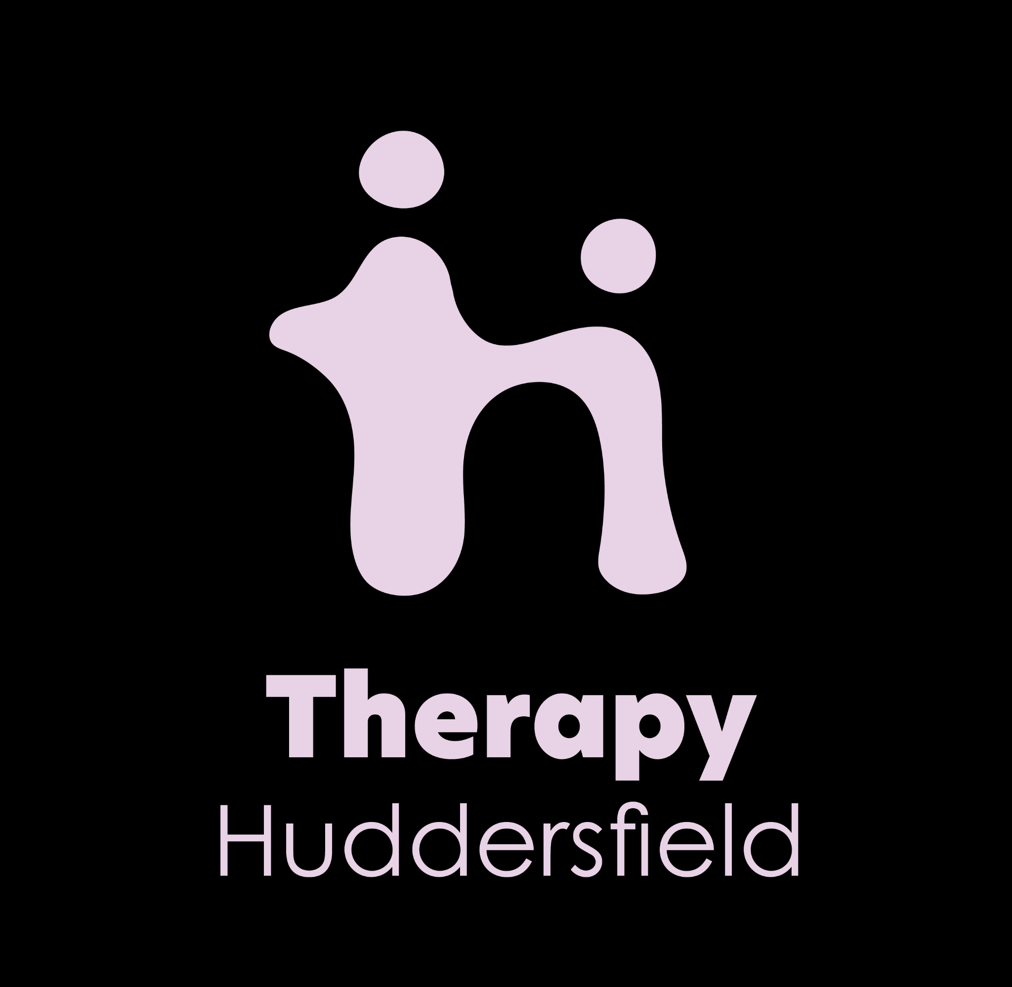

Slide 10
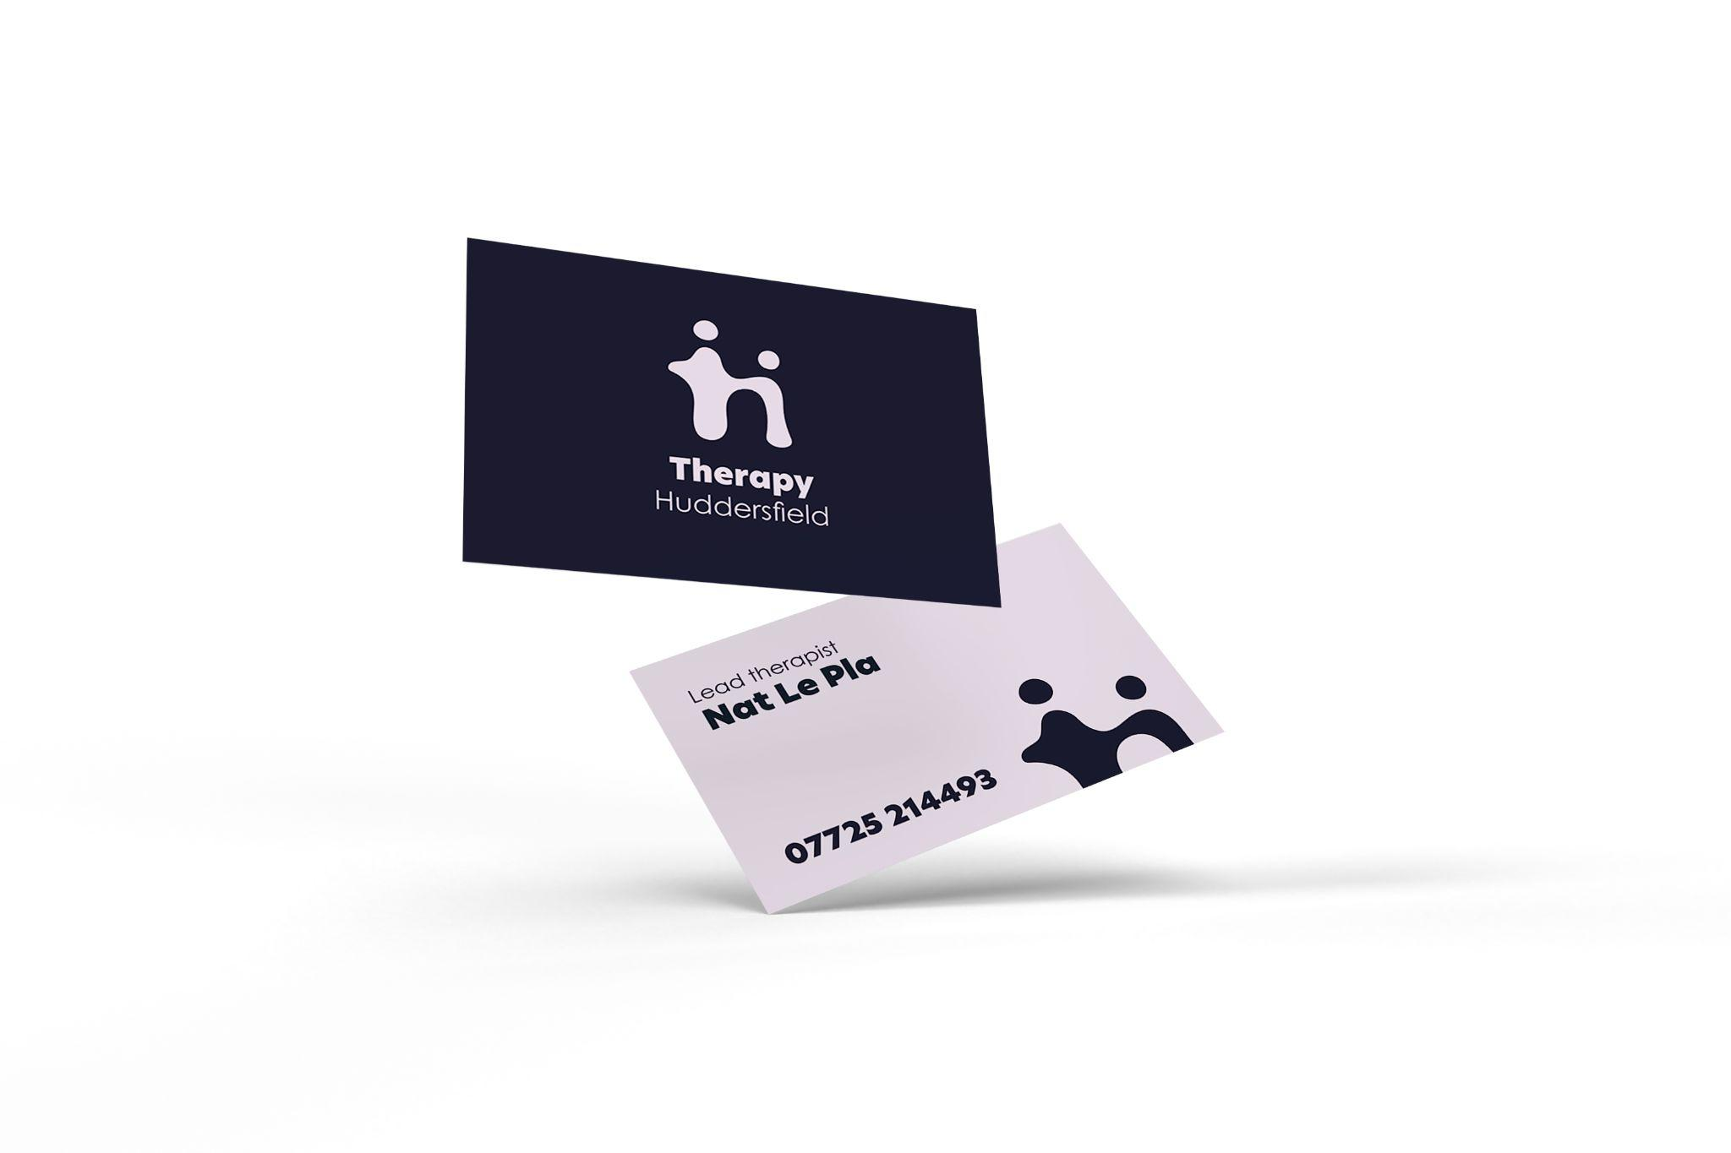

Slide 11
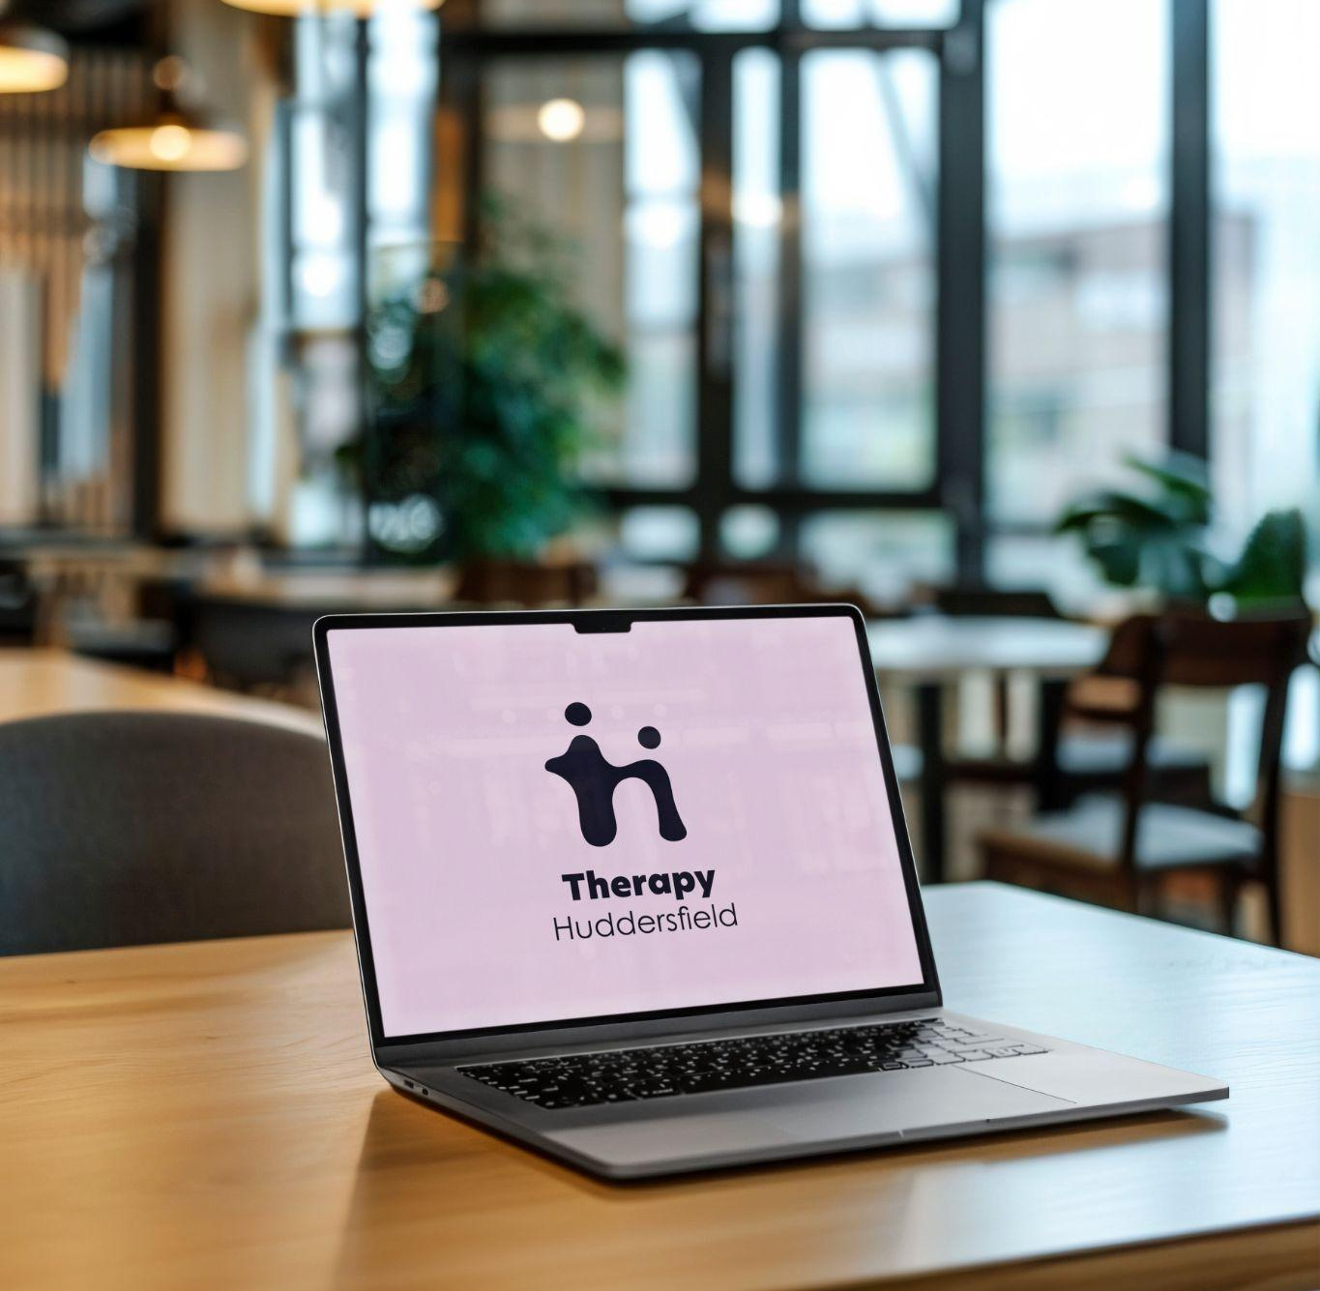
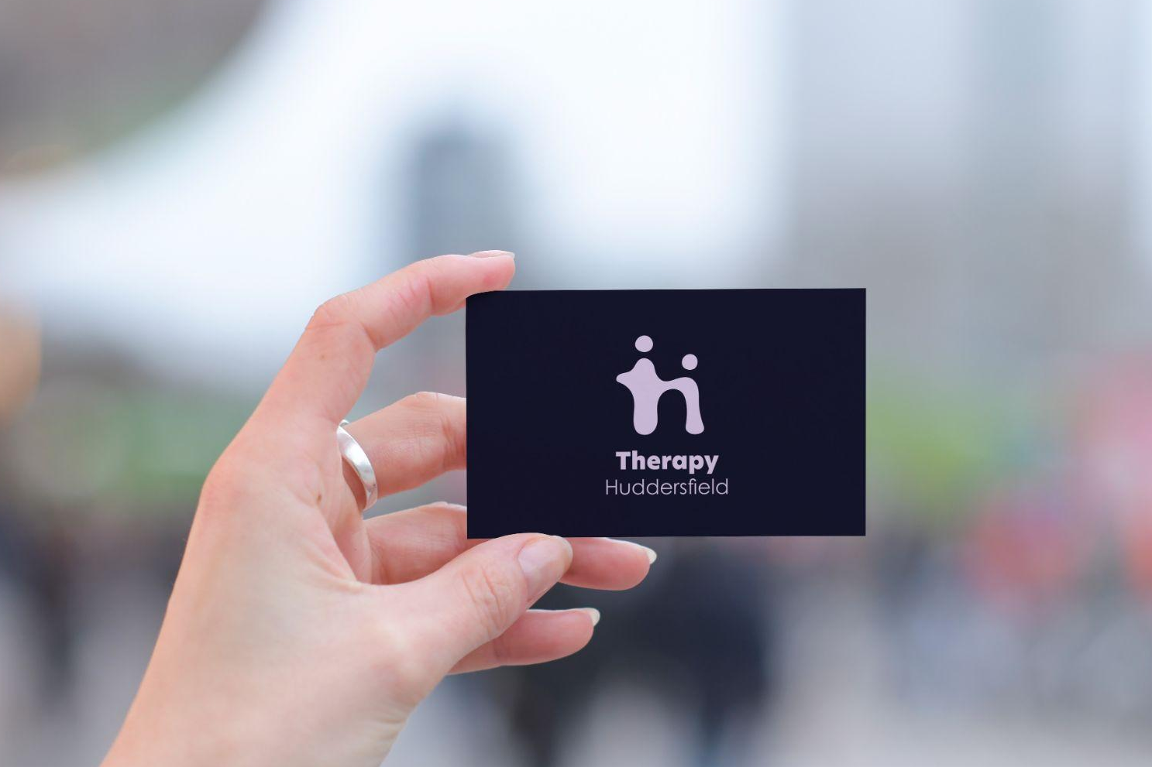

Slide 12
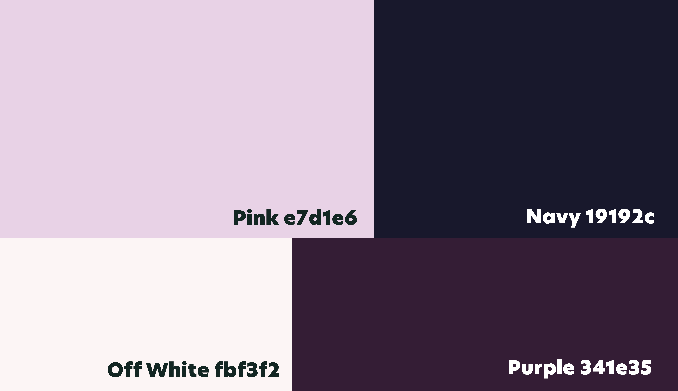

Slide 13
Logo one
Colour two

Slide 14
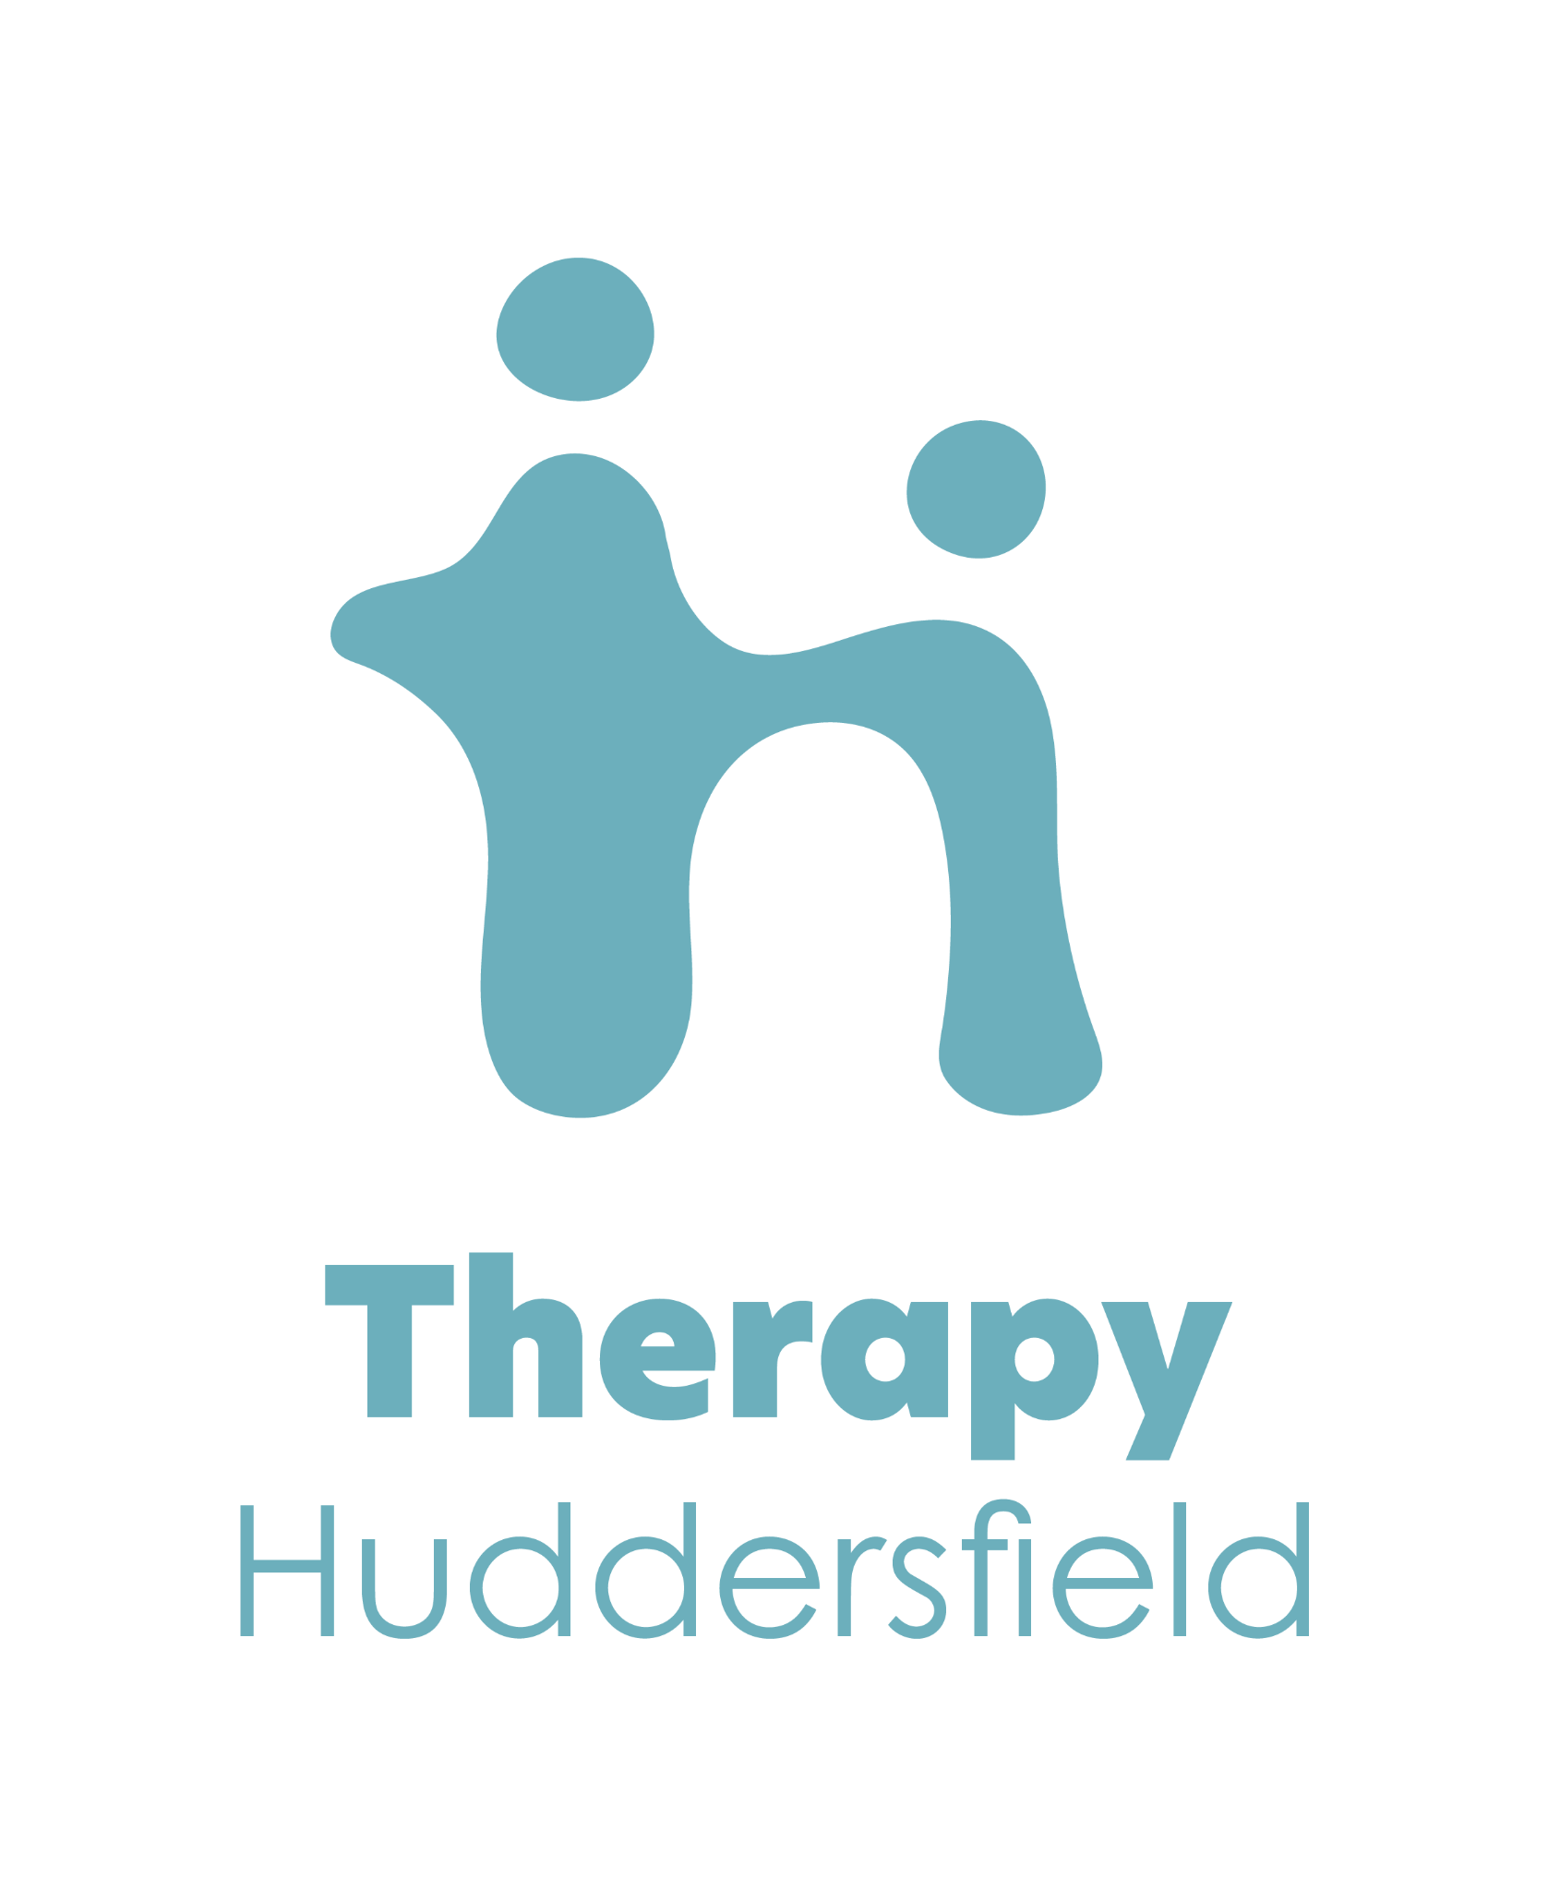

Slide 16
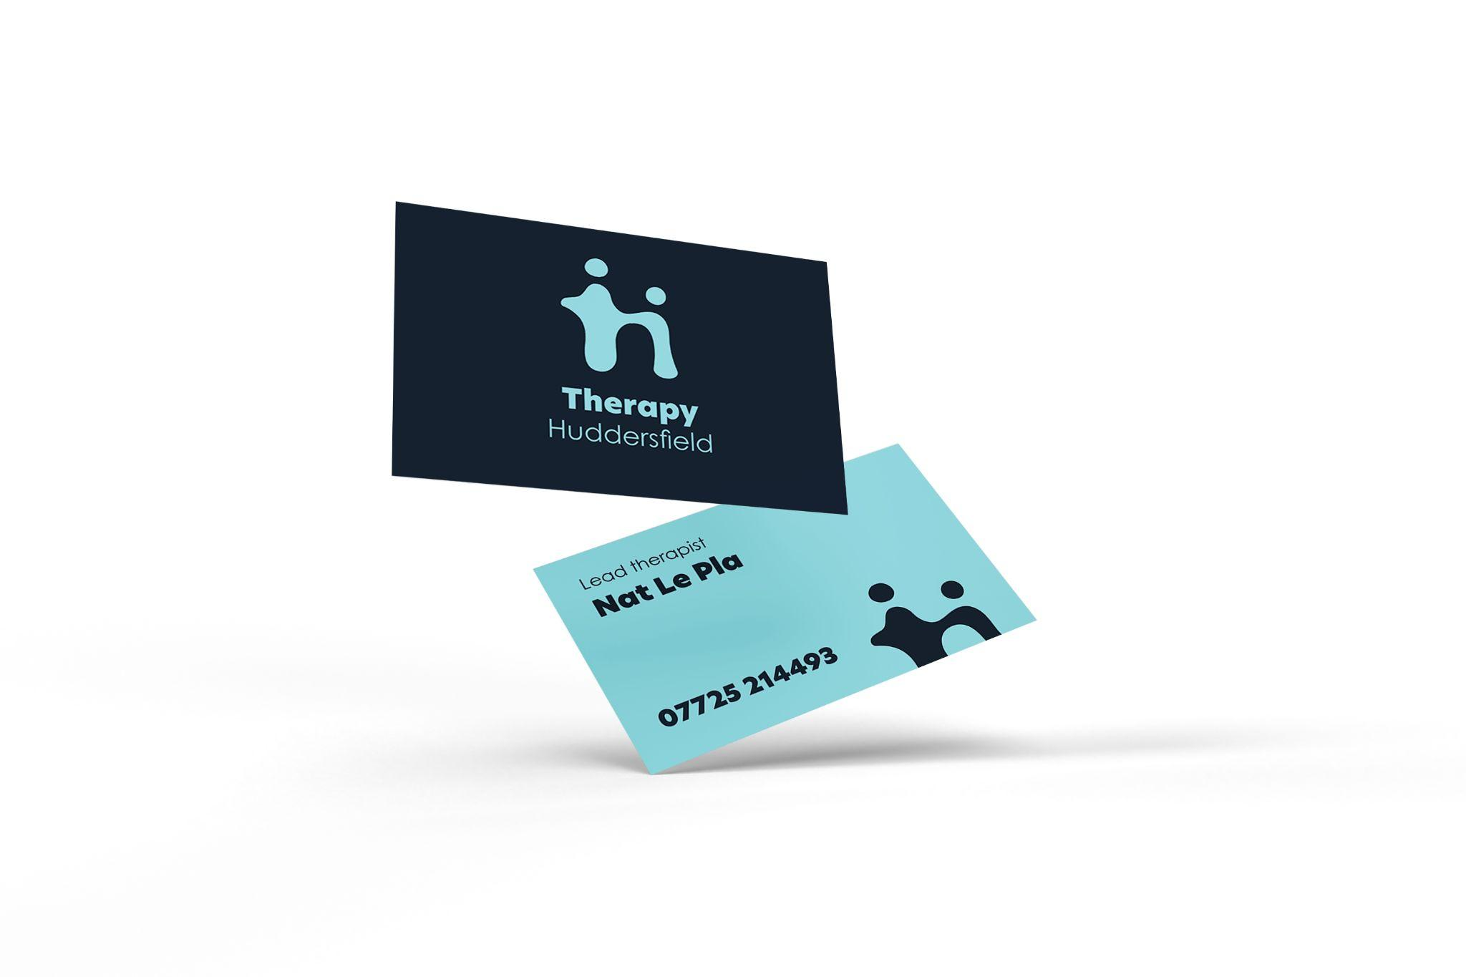

Slide 17
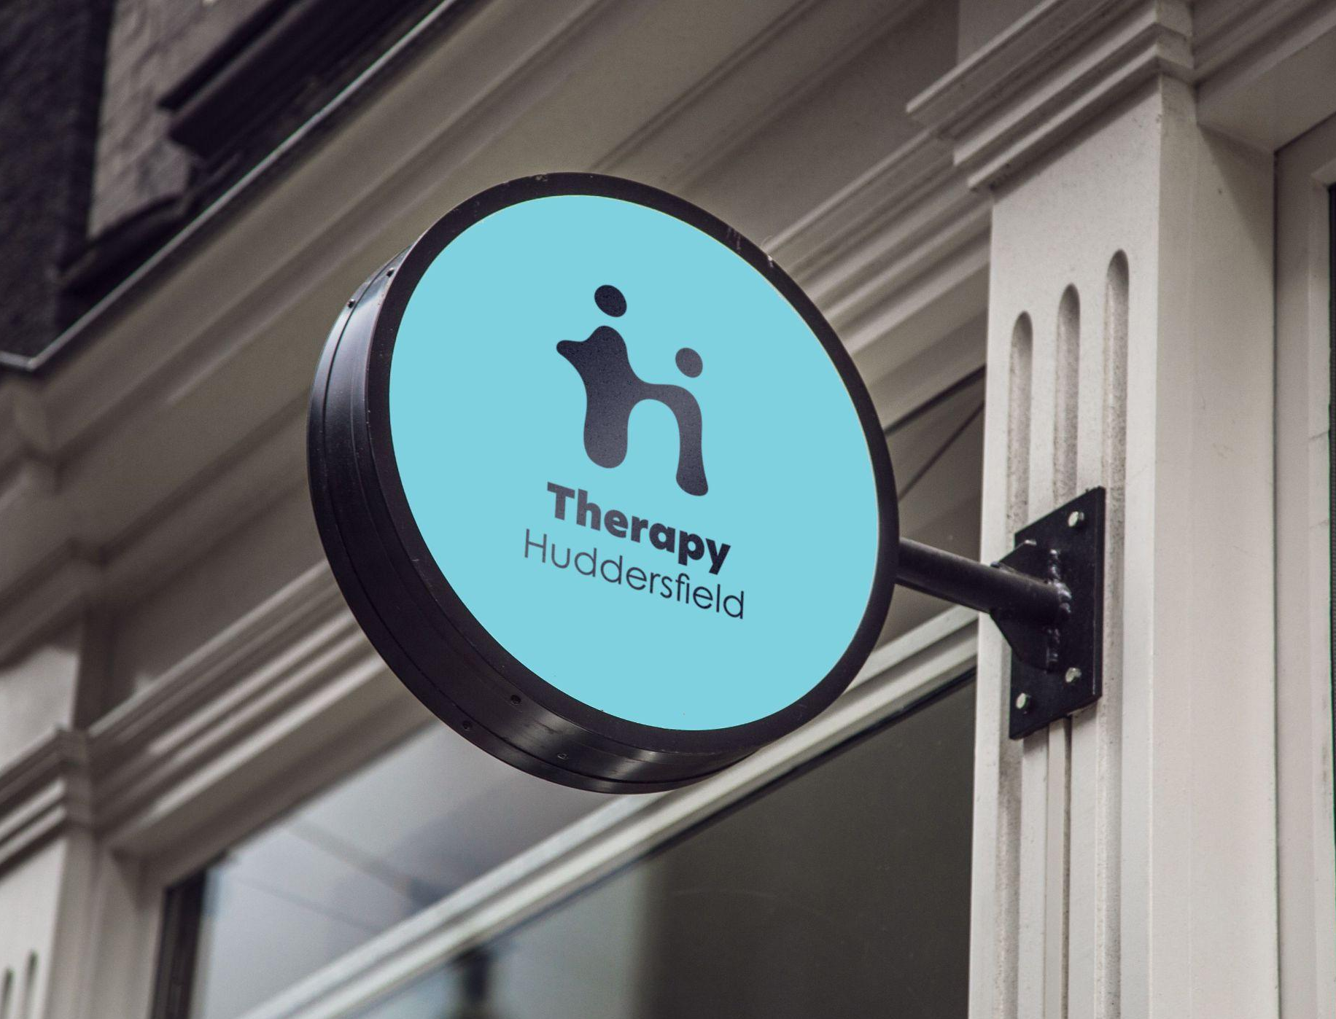
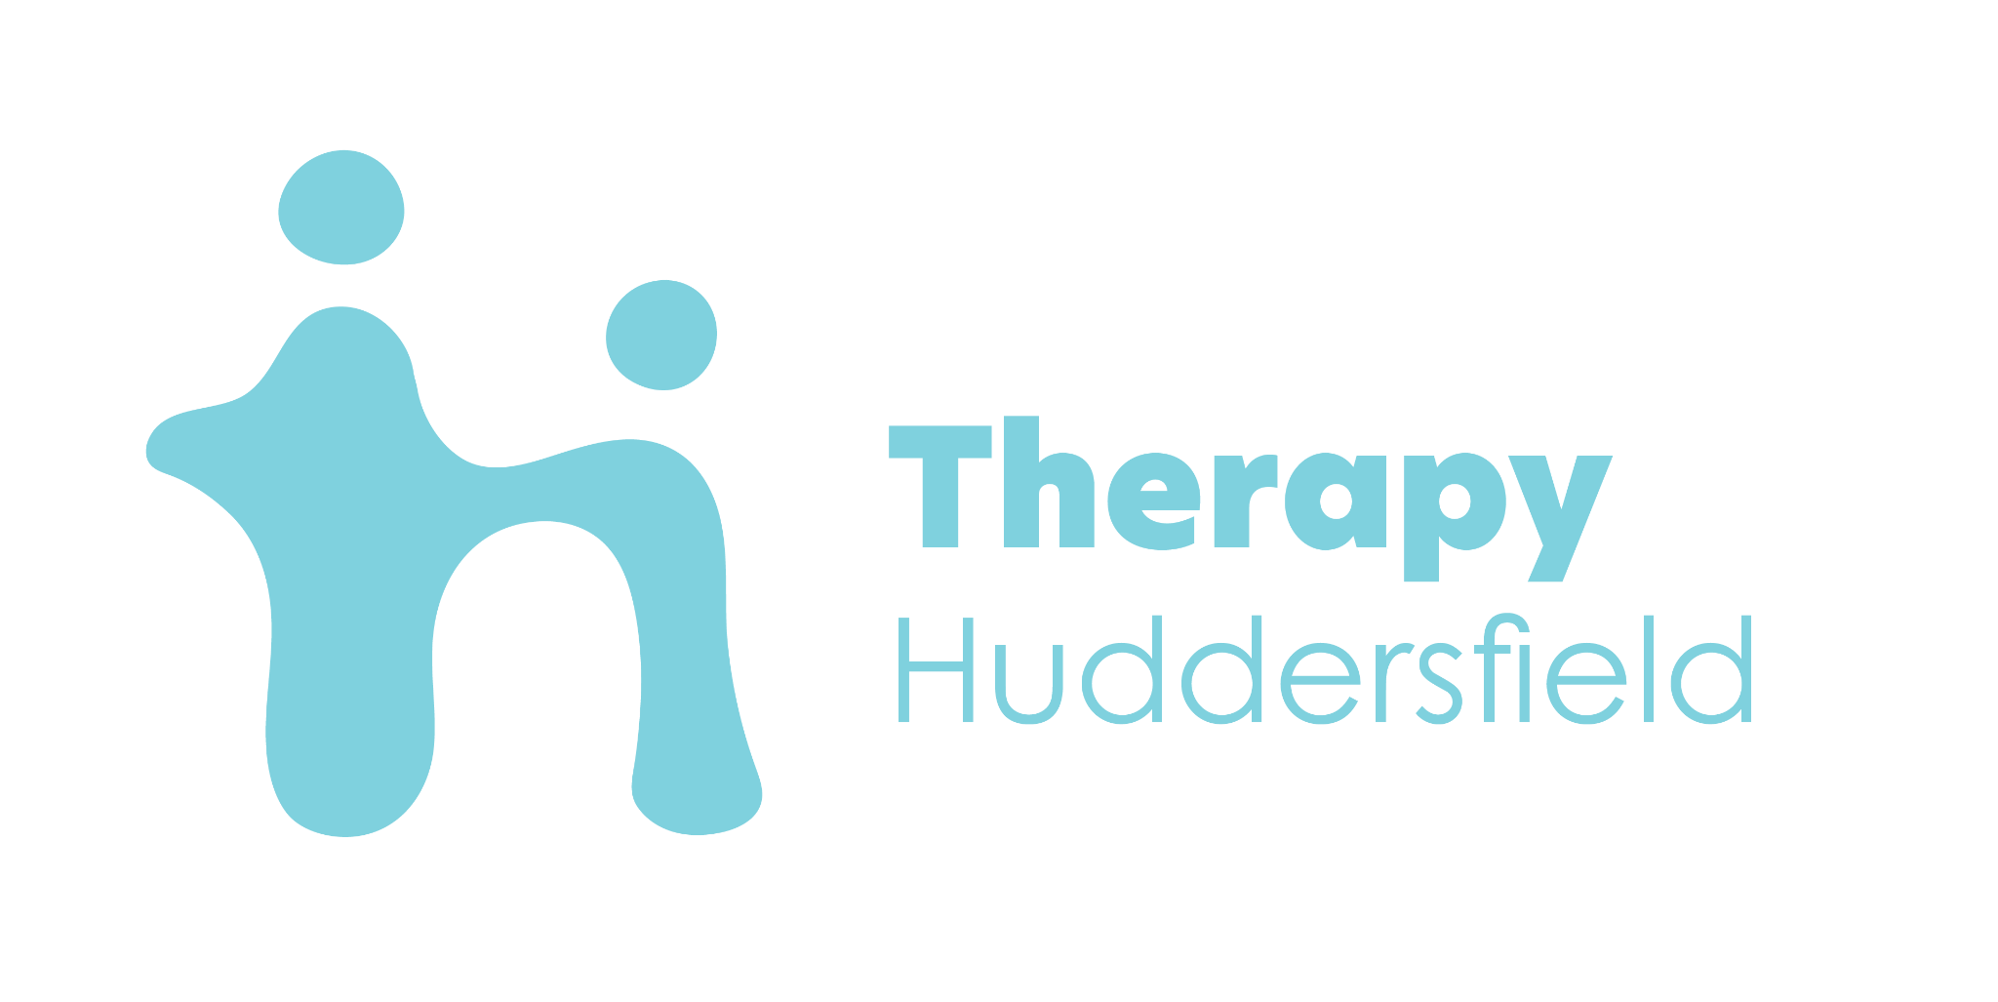

Slide 19
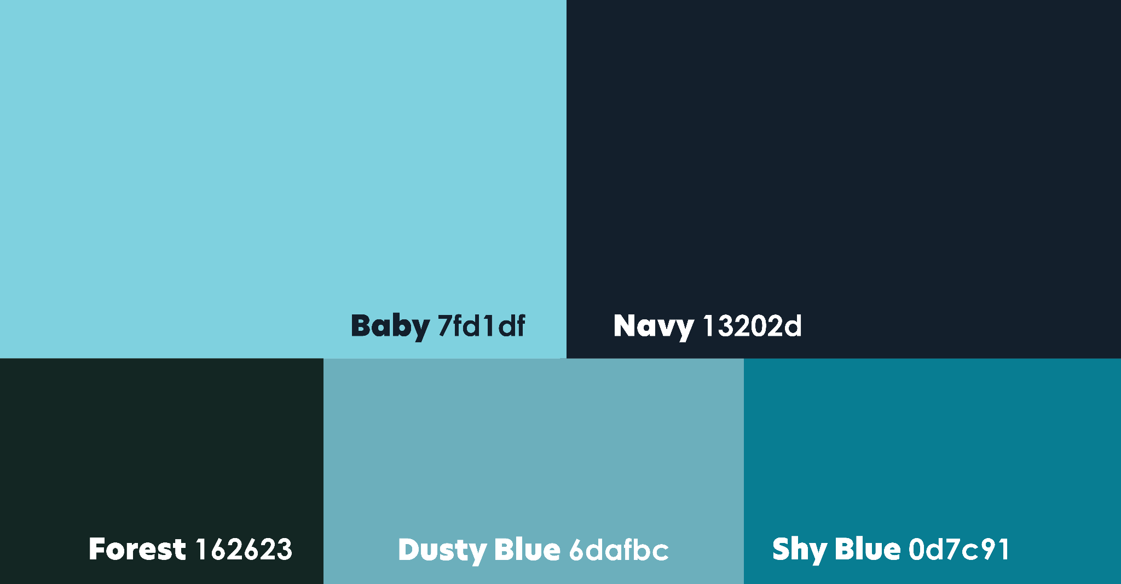

Slide 20
Logo one
Colour three

Slide 21
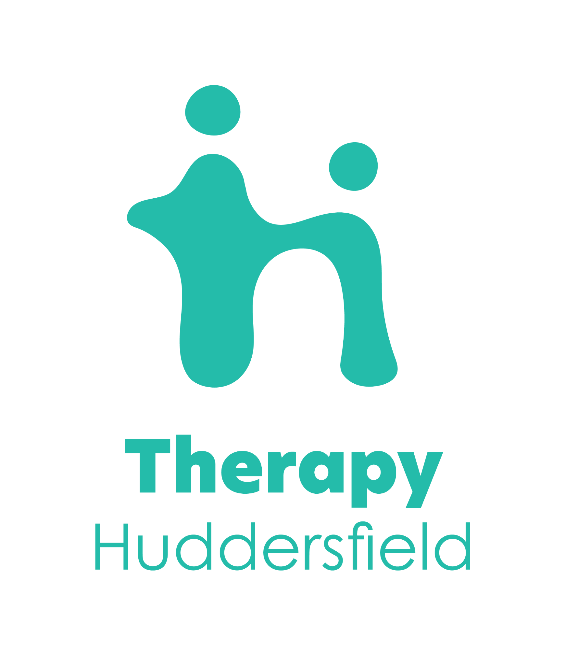

Slide 23
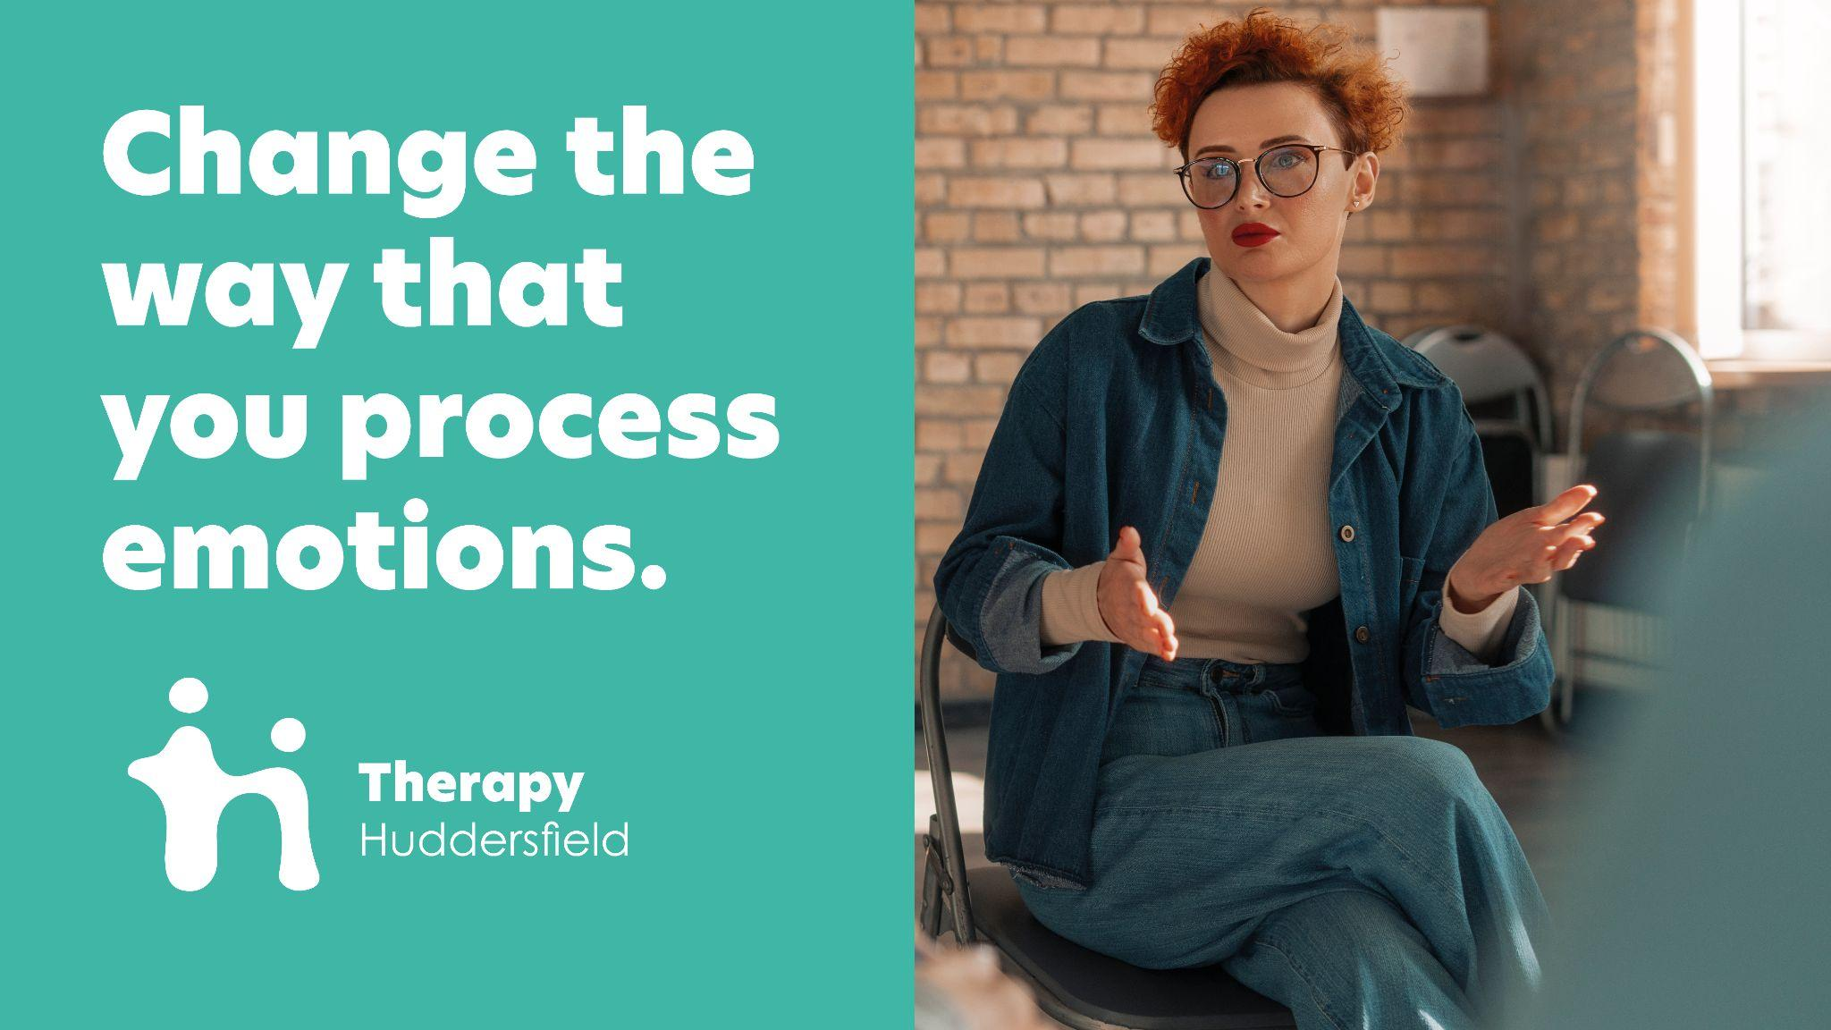

Slide 24
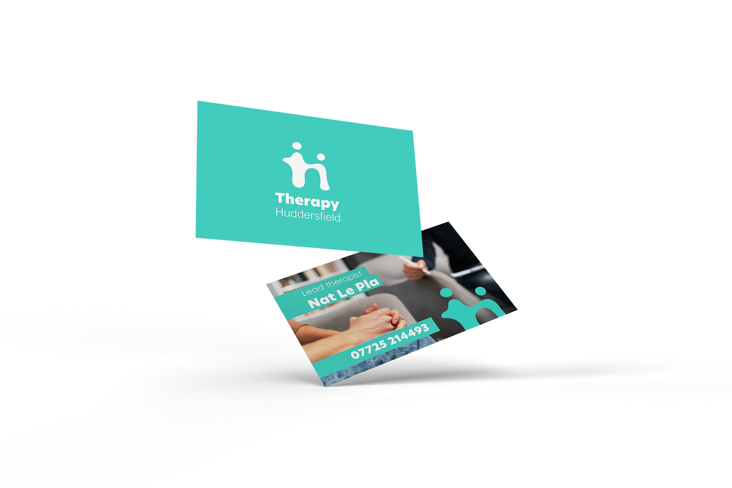

Slide 25
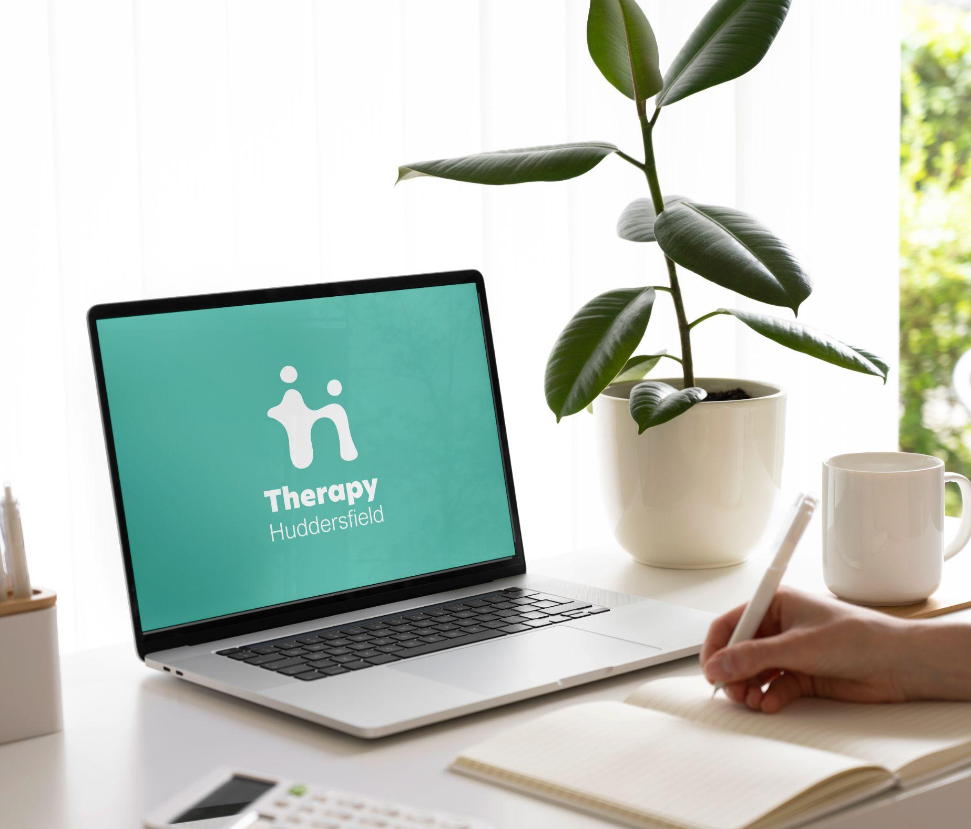

Slide 26
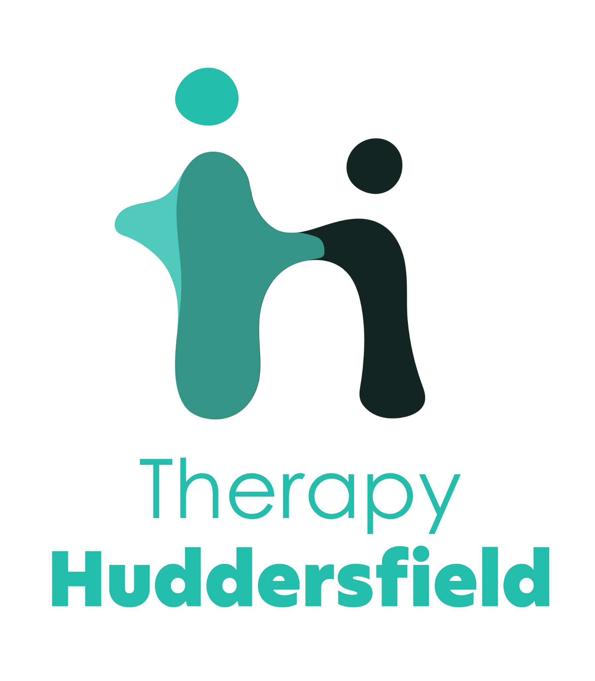

Slide 27
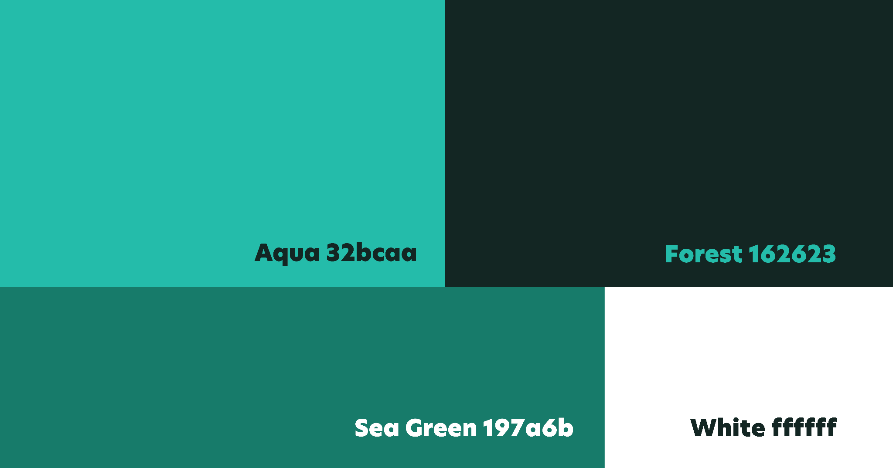

Slide 28
The client was presented with two other concepts.

