Slide 1
Concept One

Slide 4
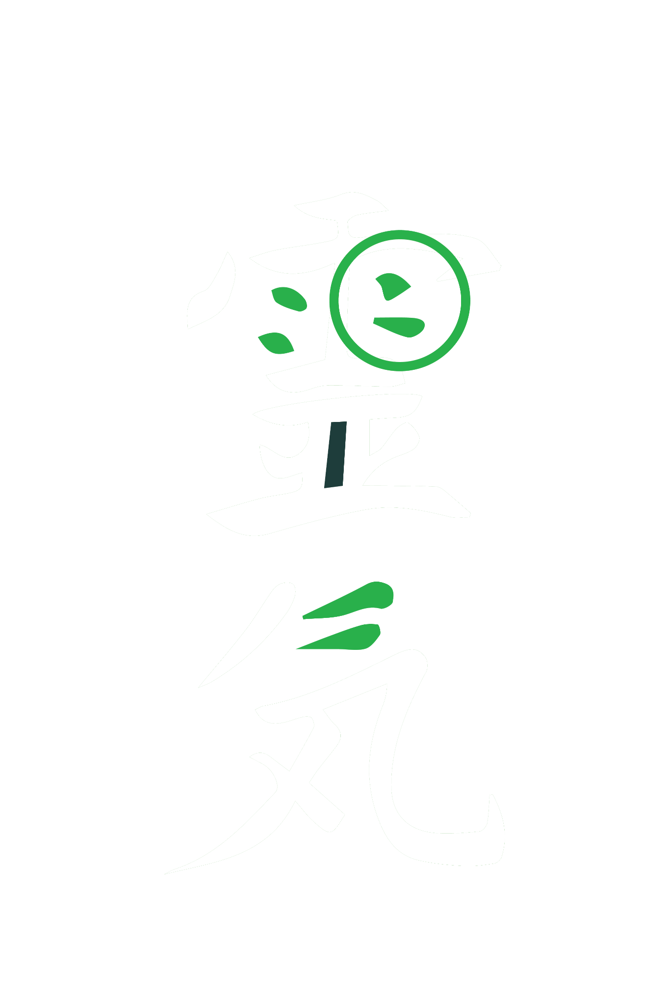
TEXT CONCEPT
The shapes from within this Reiki symbol are used as inspiration to some of the letters within the font.

Slide 5
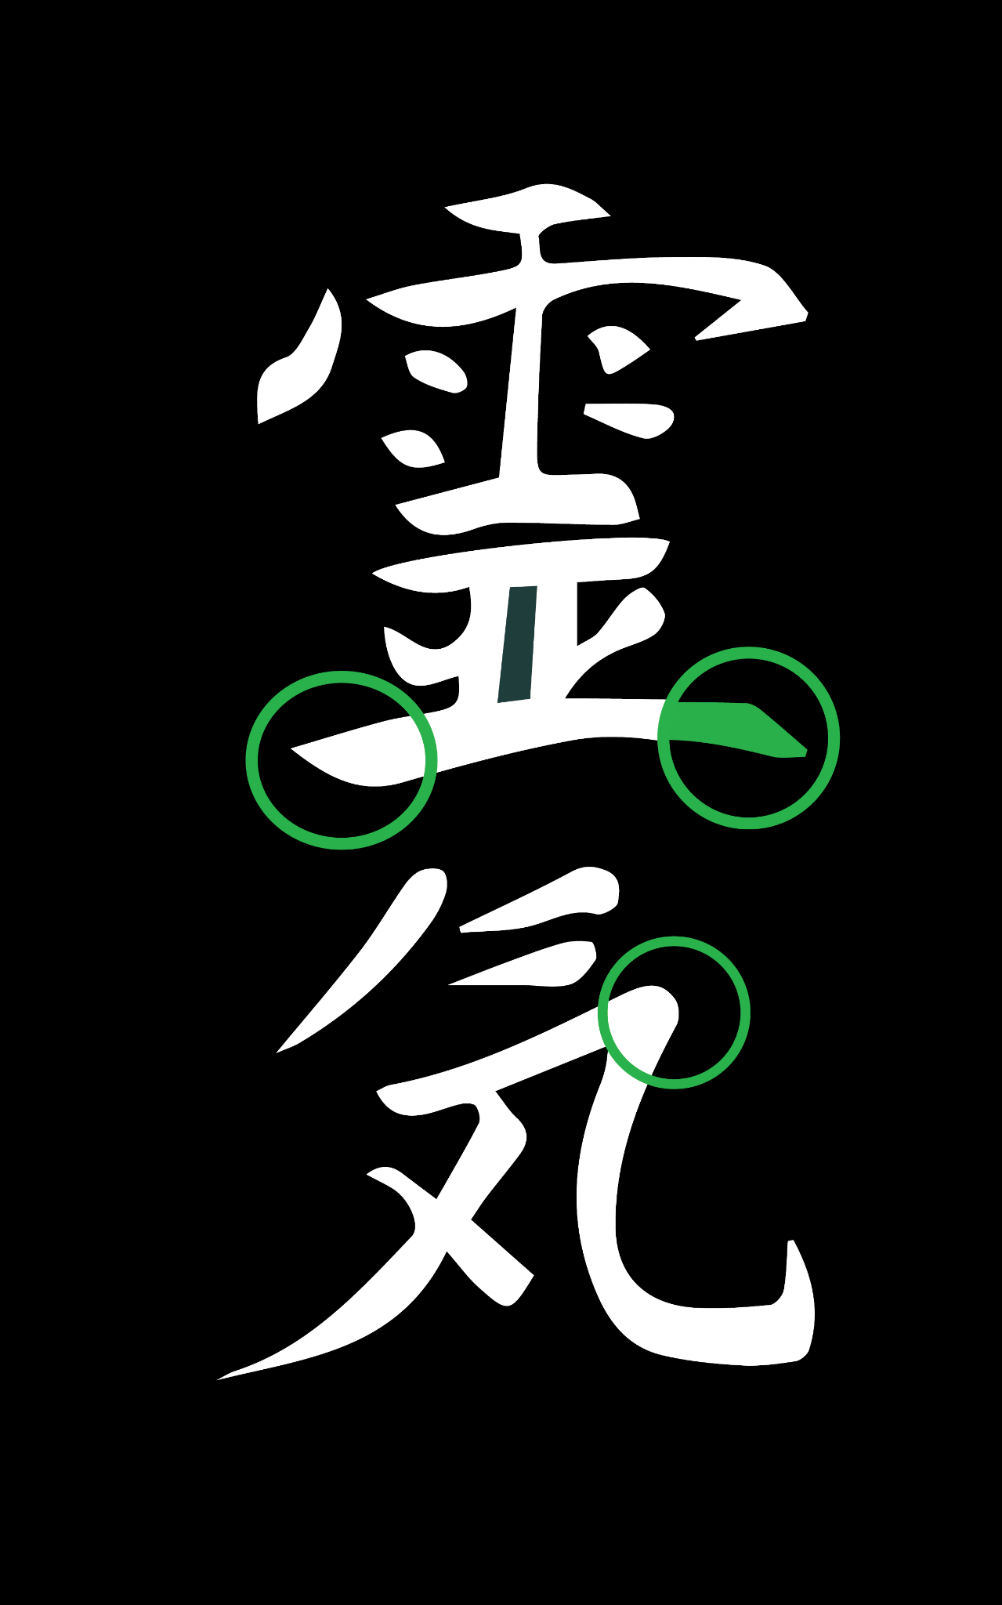
TEXT CONCEPT
The rounded yet pointed angles within the Reiki sign are used on the edges of this custom font.

Slide 6
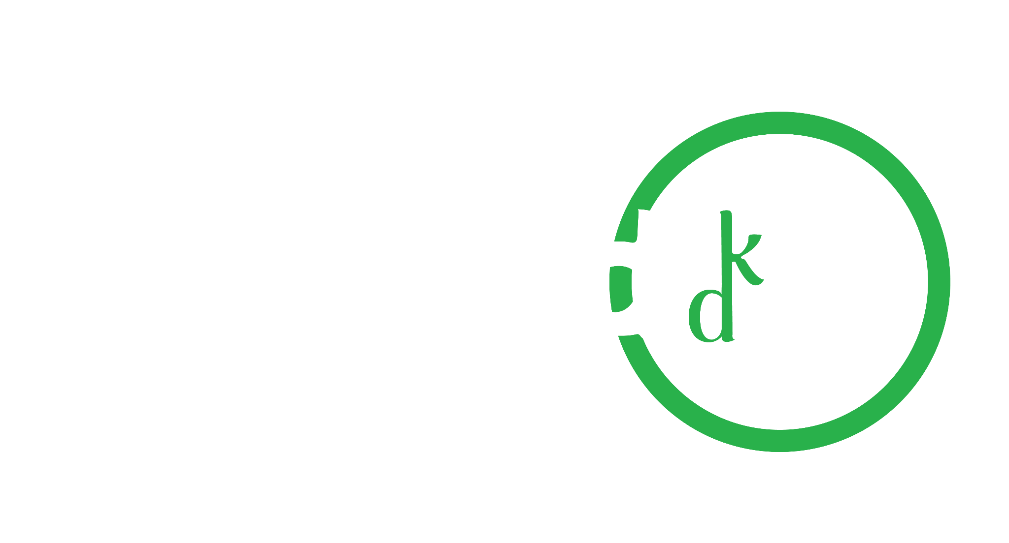
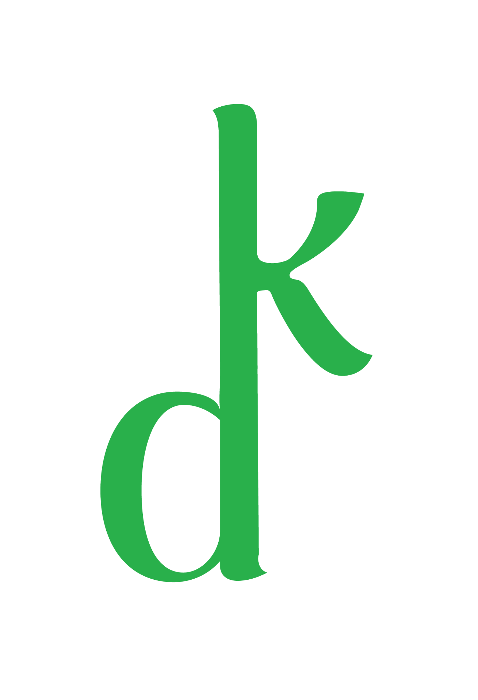
TEXT CONCEPT
By joining the ‘K’ and the ‘D’ together it emphasises the phrase ‘Skin Deep’ by showing a connection from above to below.

Slide 7
CONCEPT IDEAS

Slide 8
CONCEPT ONE
Reflect the ‘B’ from ‘Beyond’ to form a ‘D’ for ‘Deep’
BEYOND
DEEP

Slide 9
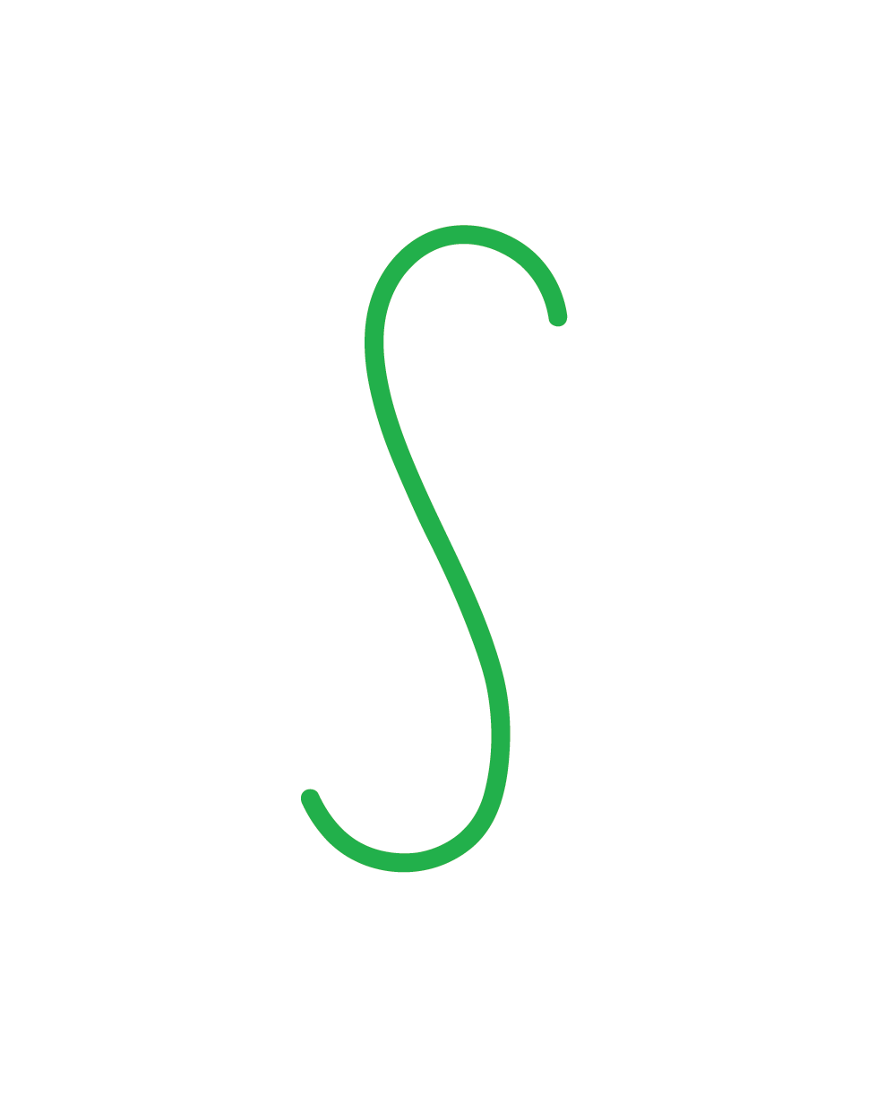
CONCEPT ONE
The infinity symbol used to represent ‘S’ for ‘Skin’
SKIN

Slide 10
DESIGNS

Slide 16
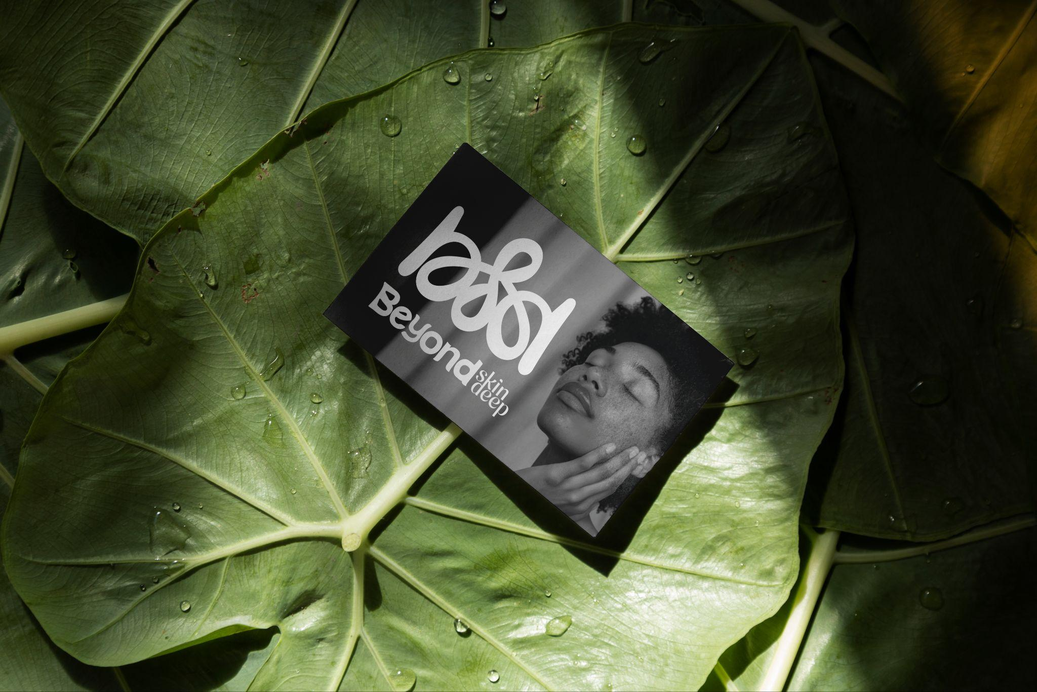

Slide 19
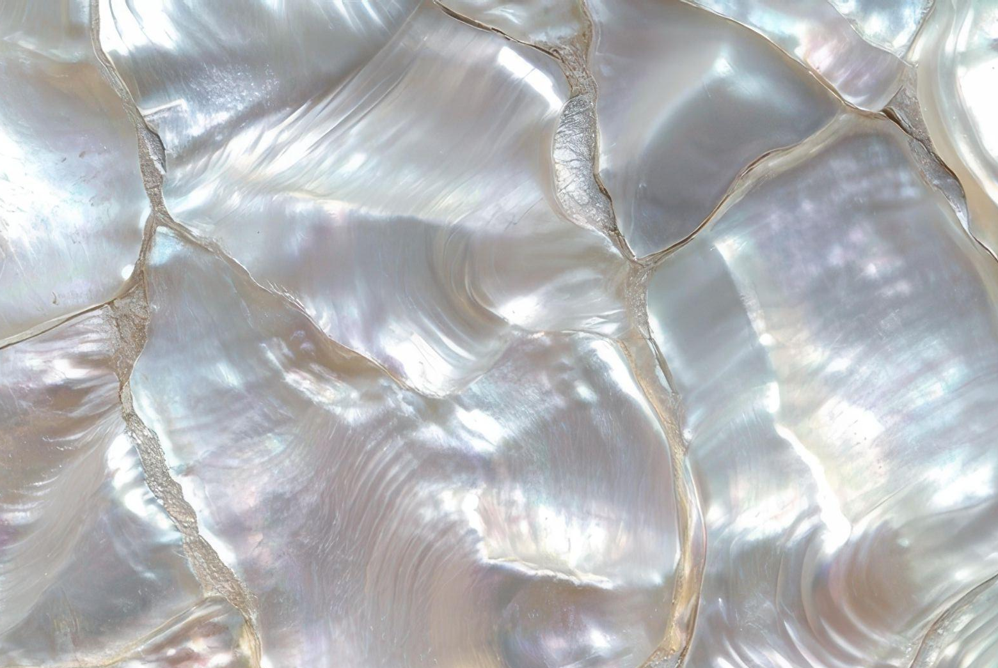
The client was presented with two other concepts.

